Slide 1
Music Classification Using SVM
Ming-jen Wang
Chia-Jiu Wang

Slide 2
Outline
Introduction
Support Vector Machine (SVM)
Implementation with SVM
Results
Comparison with other algorithms
Conclusion

Slide 3
Music Genre Classification
Human can identify music genre easily.
(play clips)
How could machines perform this task?
What would make it easier for machines?
What are the differences between the genres?

Slide 4
Motivation
Apple’s website iTunes
MP3.com
Napster.com
All boast millions of songs and over 15 genres

Slide 5
Support Vector Machine
Many decision boundaries between two classes of data
How to find the
optimal boundary?
Class 2
Class 1

Slide 6



Support Vectors
Linear SVM
Class 2
x⁺
w^{T}x_{i}+b = 1
m
x⁻
Class 1
w^{T}x_{i}+b = 0
w^{T}x_{i}+b = -1

Slide 7
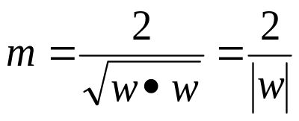
Optimal Boundary
Optimal boundary
should be as far
away from data
points in both classes
Maximize margin or
minimize w
Class 2
x⁺
w^{T}x_{i}+b = 1
m
x⁻
Class 1
w^{T}x_{i}+b = 0
w^{T}x_{i}+b = -1

Slide 8
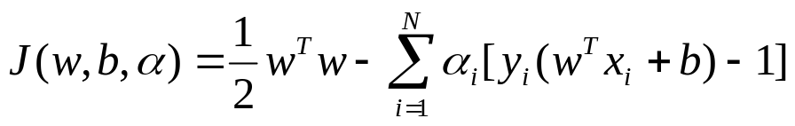
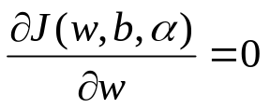
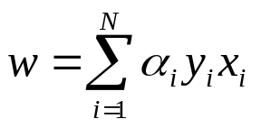
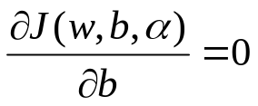
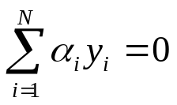
Constraint Problem
Lagrange Multiplier
Minimize the function with respect to w and b
=>
=>
After solving the Quadratic Programming problem, many α are zero. X with non-zero α are called support vectors.

Slide 9
Kernel Functions
Kernel functions transforms features to a linearly separable space
K(x)

Slide 10

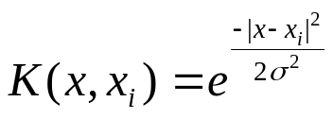

Common Kernel Functions
Polynomial
Radial Basis Function
Sigmoid

Slide 11
Implementation
Quadratic Programming
MySVM by Stefan Rueping
Matlab scripts

Slide 12
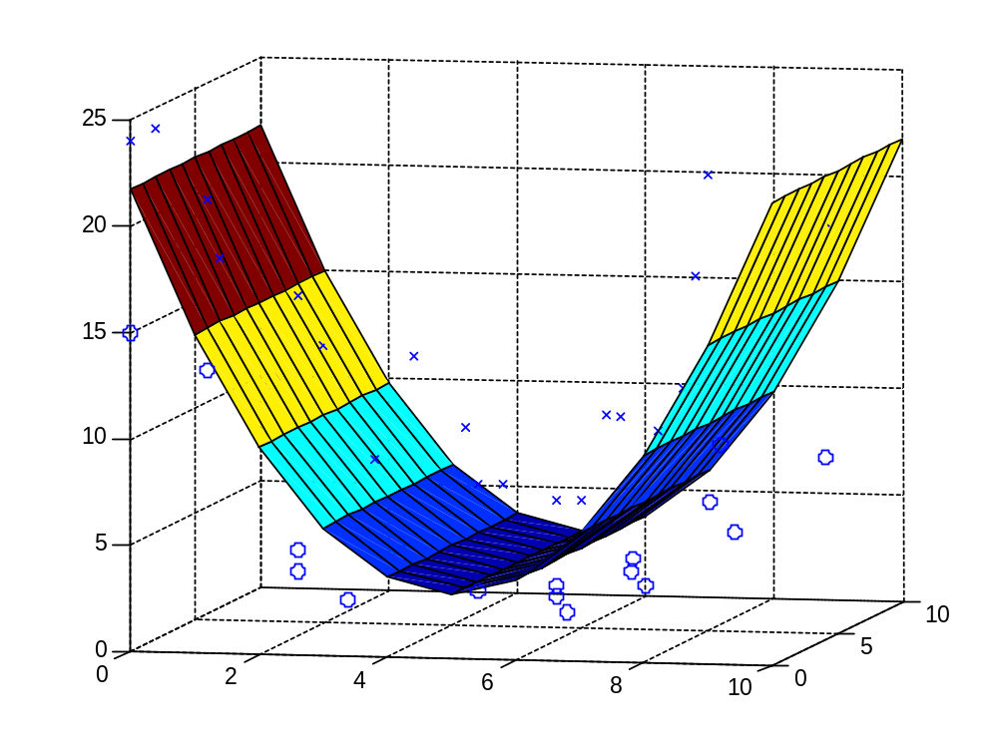
Example
Training data points

Slide 13
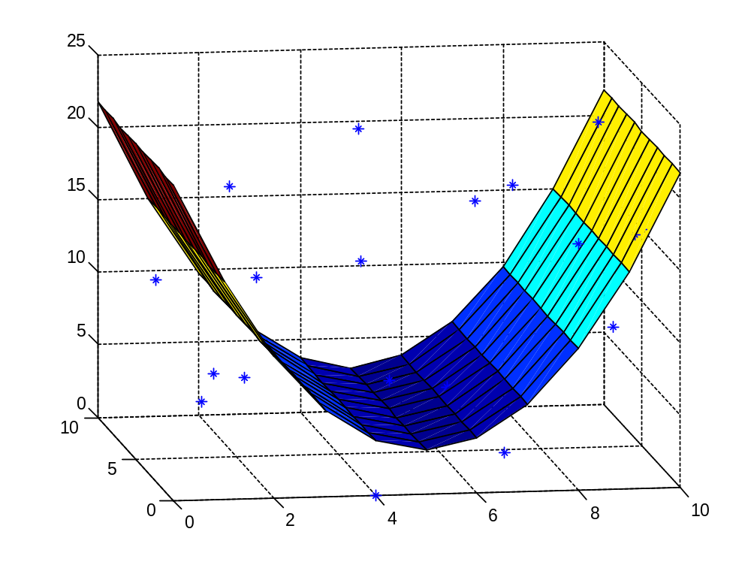
Example
Test data points

Slide 14
Example
@examples
# svm example set
dimension 3
number 20
b 2.25393
format xy
1 3 5 -2.51502
2 4 6 -0.420652
1 9 10 -2.17461
10 5 15 -0.824929
7 3 1 -2.51759
9 2 10 -0.835865
2 8 4 -2.24897
10 6 14 -1.35431
4 0 0 -4.10939
8 8 2 -3.44793
5 5 5 0.917108
3 9 10 1.4258
4 2 15 2.70503
7 2 20 4.81161
8 0 17 2.36853
9 4 23 5.4079
2 6 18 0.822491
6 4 5 0.585008
7 7 16 2.44882
5 9 20 2.64036

Slide 15
Classifying Music Genres
Many features to choose from
Using FFT spectrum
Classical, Jazz and Rock
Each genre has its dynamic range

Slide 16
Why FFT?
Other features such as MFCC (Mel-Frequency Ceptral Coefficient), LPC (Linear Predictive Coding) have been used in other papers.
Each sample is formed with only 22.7 ms worth of data.
Small number of catagories.

Slide 17
Song Collection
Total of 18 songs (6 songs per genre)
About 40000 samples overall
Over 10000 used for training
30000 samples were used for testing

Slide 18
Song Collection
Artists include Nora Jones, Zoltan Tokos and Budapest Strings, Blink 182, Goo Goo Dolls, Green Day and MatchBox 20
Most of the files are recorded at 128kbps and sampled at 44.1kHz.

Slide 19
Feature Extraction
Process flow
.
.
.
.
.
.
.
.
Partition the file into n-second clips
MP3
Conversion Utility
WAV
Input Vectors
FFT

Slide 20
Feature Extraction
Convert MP3 to Windows wav format
Preprocess with Matlab scripts
Partition into 1024 point clips
Perform 1024-point FFT

Slide 21
Evaluation
Samples are divided into two pools, training pool and testing pool.
Samples in training pool are used to train all 3 SVM.
Samples in testing pool are used to evaluate the accuracy.

Slide 22
1v1 and 1v2 SVM
Instead of training with one class vs. another, train the SVM with one class vs. two classes. [ie: Classical (1) vs Jazz (-1), Classical (1) vs Jazz and Rock (-1)]
1v1 produces better result than 1v2.

Slide 23
Certain Combination Produces Better Result
 | Classical |  | Jazz |  | Rock
SVM | CvJ | RvC | CvJ | JvR | RvC | JvR
Accuracy (%) | 98 | 97 | 80.5 | 79.5 | 95 | 48

Slide 24
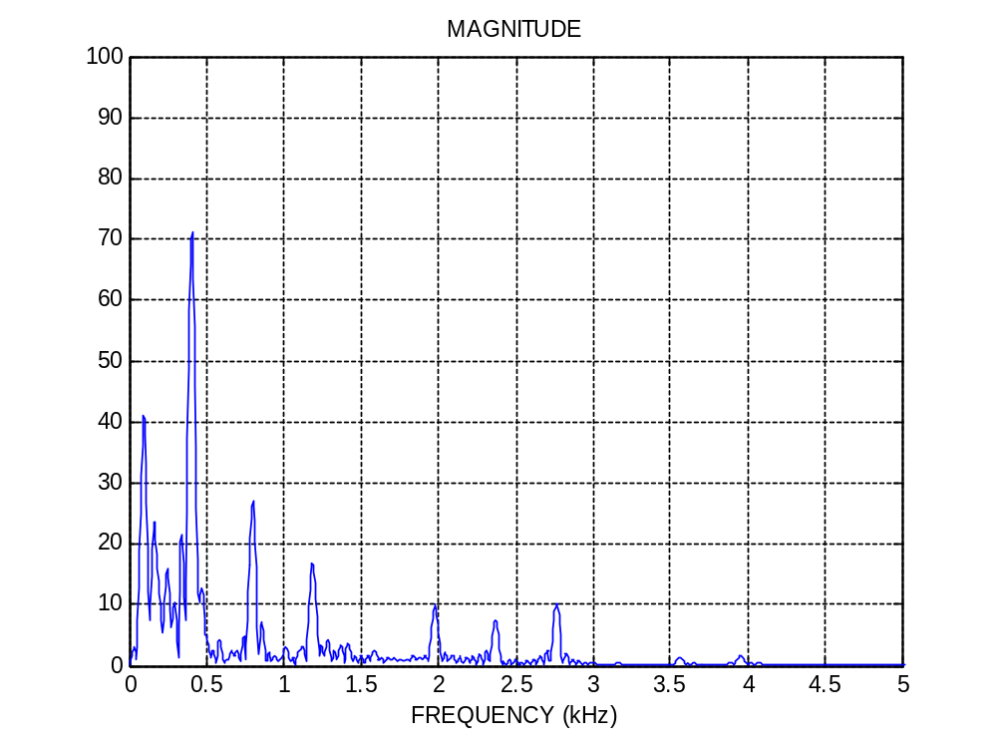
Classical Spectrum

Slide 25
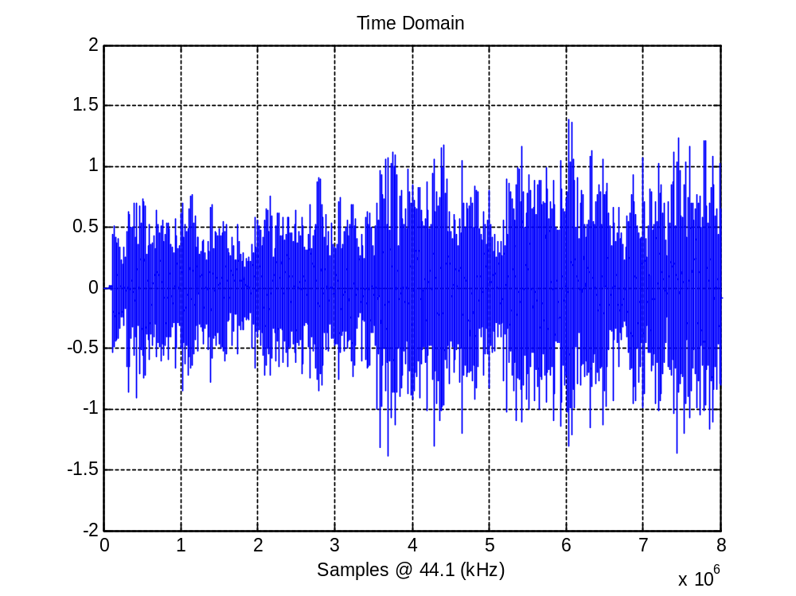
Classical in Time Domain

Slide 26
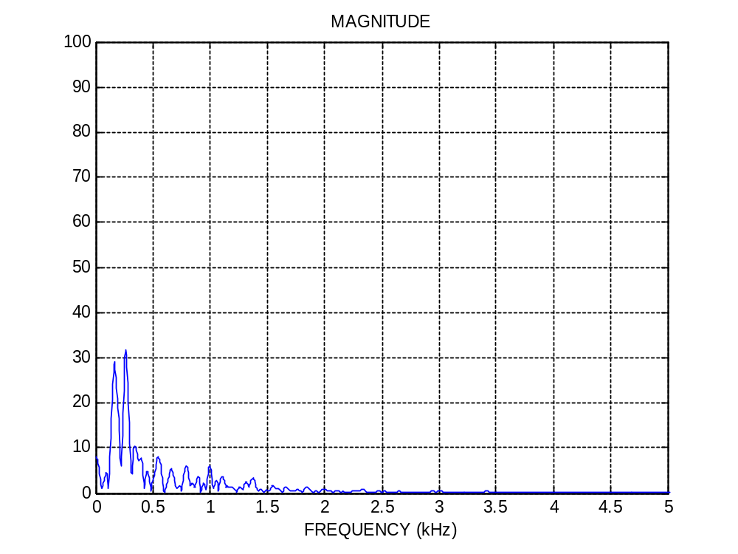
Jazz Spectrum

Slide 27
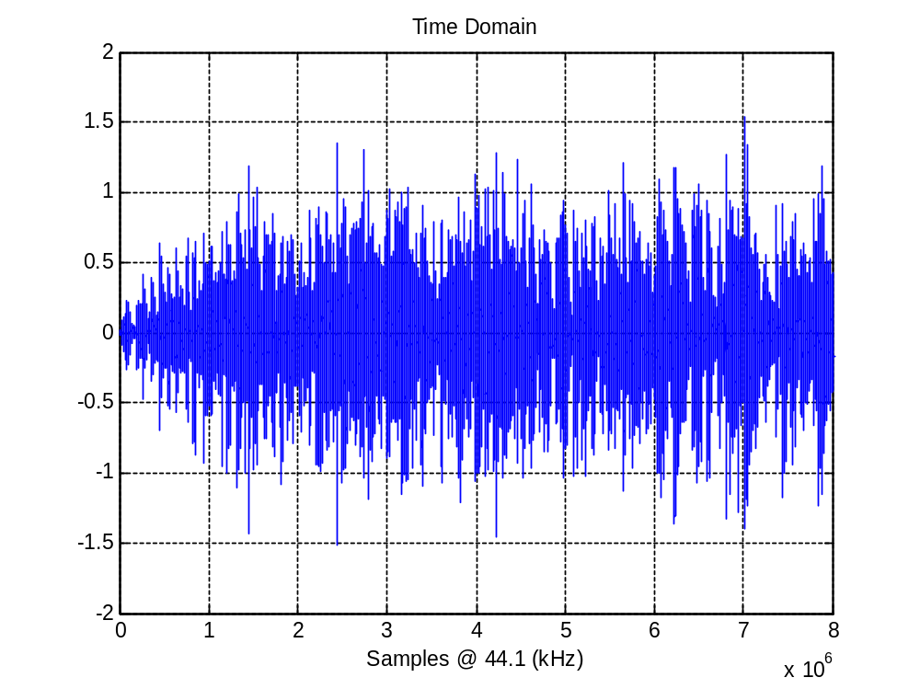
Jazz in Time Domain

Slide 28
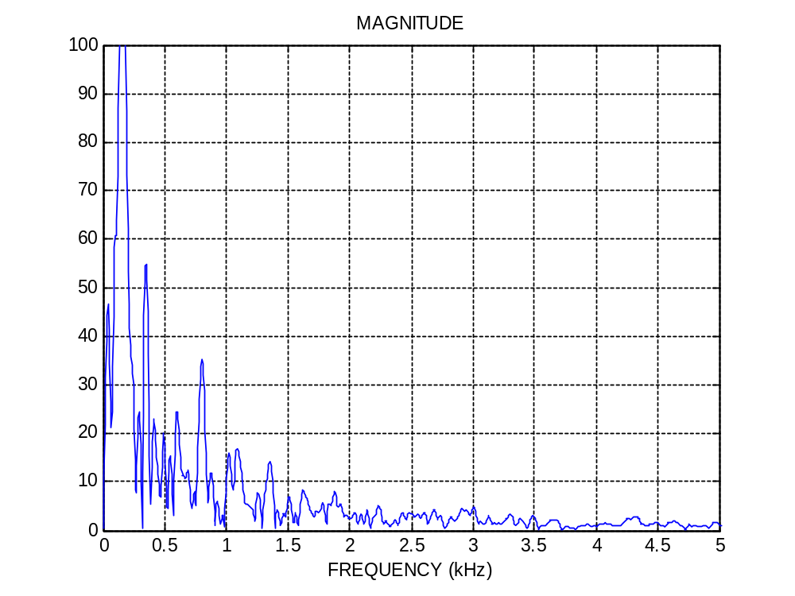
Rock Spectrum

Slide 29
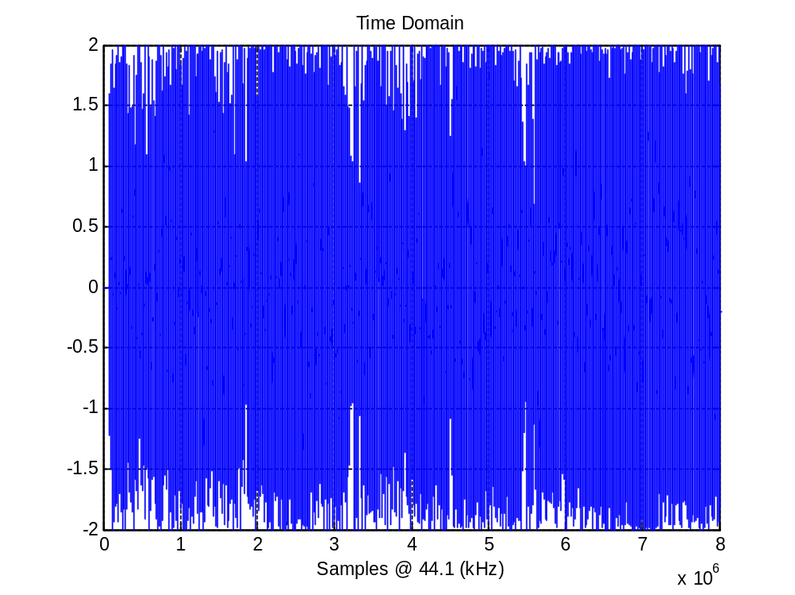
Rock in Time Domain

Slide 30
Sample-Set Method
1 sample-set = 100 individual samples
Average the scores for each class
Take the class of maximum as the classifier

Slide 31
Decision Strategy Chart
Sample
CvJ SVM
RvC SVM
JvR SVM
CvJ
CvR
JvC
JvR
RvC
RvJ
90%
85%
10%
45%
15%
55%
Avg
Avg
Avg
87.5%
27.5%
35%
Max
C

Slide 32
Another example
Sample
CvJ SVM
RvC SVM
JvR SVM
CvJ
CvR
JvC
JvR
RvC
RvJ
58%
15%
42%
25%
85%
75%
Avg
Avg
Avg
36.5%
33.5%
80%
Max
R

Slide 33
Spreadsheet based on the chart
Set | classical |  | Jazz |  | Rock |  | classical | jazz | rock
 | CvJ | CvR | JvC | JvR | RvC | RvJ | average | average | average | max
1 | 97 | 100 | 3 | 100 | 0 | 0 | 98.5 | 51.5 | 0 | C
2 | 96 | 100 | 4 | 100 | 0 | 0 | 98 | 52 | 0 | C
3 | 99 | 100 | 1 | 100 | 0 | 0 | 99.5 | 50.5 | 0 | C
4 | 99 | 100 | 1 | 100 | 0 | 0 | 99.5 | 50.5 | 0 | C
5 | 89 | 100 | 11 | 100 | 0 | 0 | 94.5 | 55.5 | 0 | C
6 | 91 | 100 | 9 | 100 | 0 | 0 | 95.5 | 54.5 | 0 | C
7 | 87 | 100 | 13 | 100 | 0 | 0 | 93.5 | 56.5 | 0 | C
8 | 96 | 100 | 4 | 100 | 0 | 0 | 98 | 52 | 0 | C
9 | 83 | 100 | 17 | 100 | 0 | 0 | 91.5 | 58.5 | 0 | C
10 | 90 | 100 | 10 | 100 | 0 | 0 | 95 | 55 | 0 | C
11 | 91 | 100 | 9 | 100 | 0 | 0 | 95.5 | 54.5 | 0 | C
12 | 92 | 100 | 8 | 99 | 0 | 1 | 96 | 53.5 | 0.5 | C
13 | 77 | 100 | 23 | 100 | 0 | 0 | 88.5 | 61.5 | 0 | C

Slide 34
Individual Result
600 Samples | Classical | Jazz | Rock
Classical | 196 | 41 | 10
Jazz | 4 | 159 | 0
Roc | 0 | 0 | 190
Accuracy | 98% | 79.5% | 95%

Slide 35
Sample Set Result
300 Sample-set | Classical | Jazz | Rock
Classical | 99 | 0 | 0
Jazz | 1 | 96 | 6
Rock | 0 | 4 | 94
Accuracy | 99% | 96% | 94%

Slide 36
Other Algorithms
Neural Network
Gaussian Classifier
Hidden Markov Model

Slide 37
Gaussian Classifier [7]
Feature vector used is a conglomeration of different types of features. (mean-centroid, mean-rolloff, mean-flux, mean-zero-crossing, std-centroid, std-rolloff, std-flux, std-zero-crossing and LowEnergy)
6 genres, Classical, Country, Disco, Hiphop, Jazz, Rock.
Each classifier is trained by 50 samples each 30 seconds in length.

Slide 38
Neural Network Approach [8]
Feature vector includes LPC taps, DFT amplitude, log DFT amplitude, IDFT of log DFT amplitude, MFC and Volume.
4 genres: Classical, Rock, Country and Soul/R&B.
8 CDs, 2 of each. 4425 feature vectors. Half is used for training, half for testing.

Slide 39
Comparison with other algorithms
Accuracy | Classical | Jazz | Rock
Gaussian Classifier [7] | 86% | 38% | 49%
Neural Network [8] | 97% | n/a | 93%
SVM (individual sample) | 98% | 79.5% | 95%
SVM (sample-set) | 99% | 96% | 94%

Slide 40
Summary
Sample-Set method produces better result than individual samples.
SVM results are comparable to Neural Network results
Only used one feature

Slide 41
Other Applications of SVM
Optical Character Recognition
Hand-Writing Recognition
Image Classification
Voice Recognition
Protein Structure Prediction
Notes:
i

Slide 42
Conclusion
Viable approach for music classification
More distinct features
Larger scale evaluation
Possible embedded application

Slide 43
Questions ???

